Slide 1
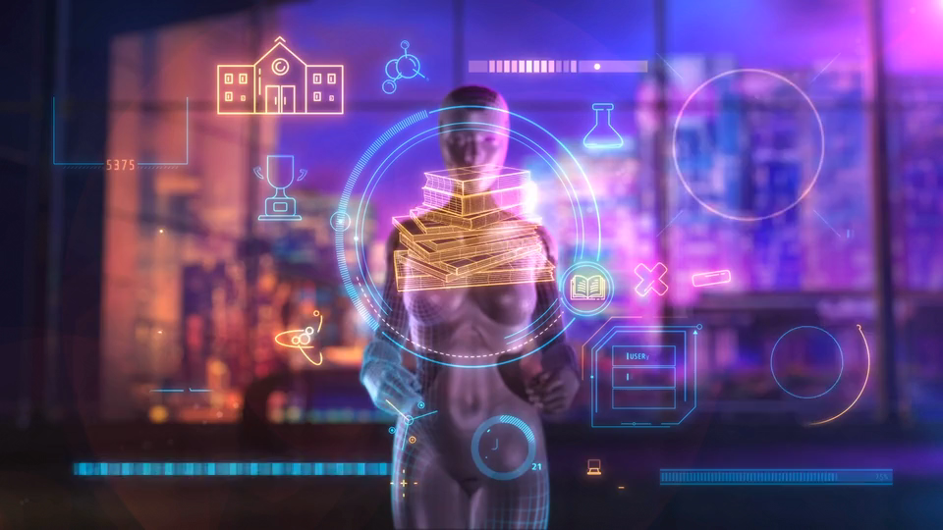
職場故事
nizima Live
Notes:
https://pixabay.com/videos/artificial-intelligence-technology-183107/

Slide 2
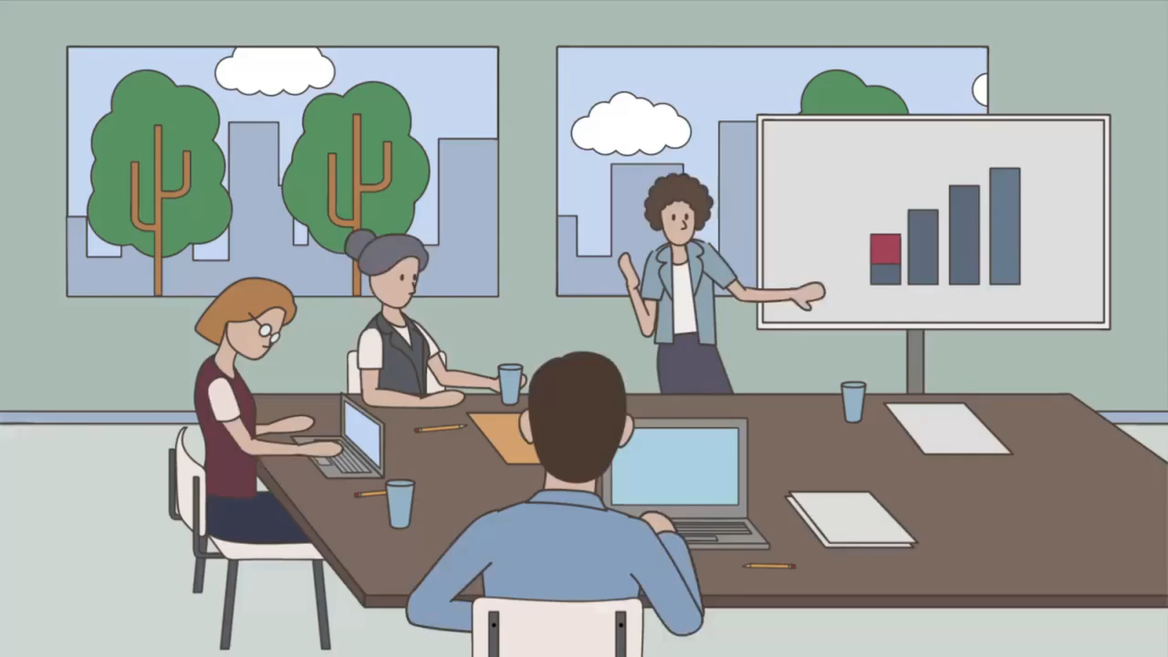
目標
Notes:
https://pixabay.com/videos/meeting-meeting-in-office-54326/

Slide 3
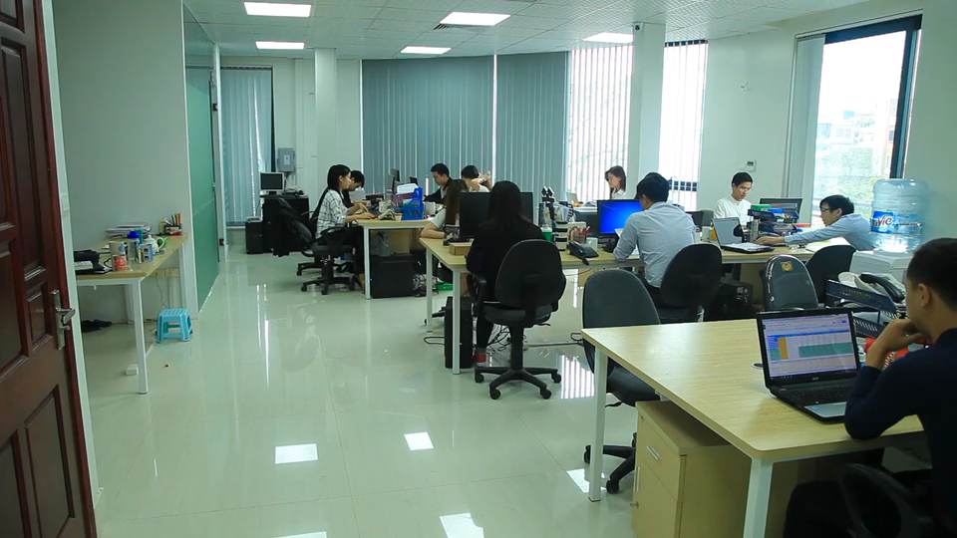
阻礙
Notes:
https://pixabay.com/videos/work-office-people-working-87593/

Slide 4
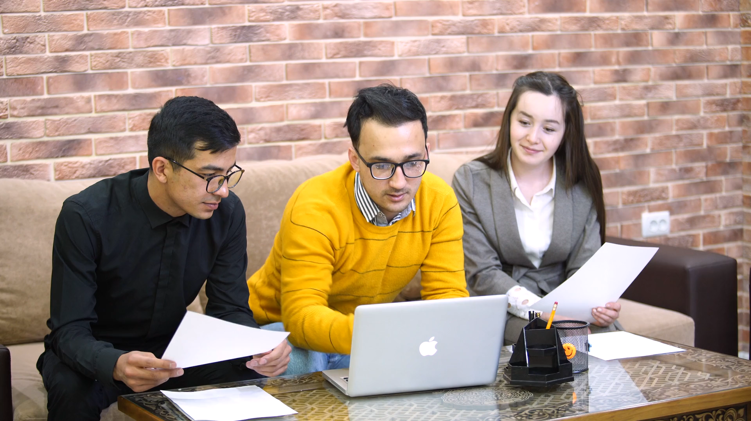
努力
Notes:
https://pixabay.com/videos/girl-office-w-computer-work-27091/

Slide 5
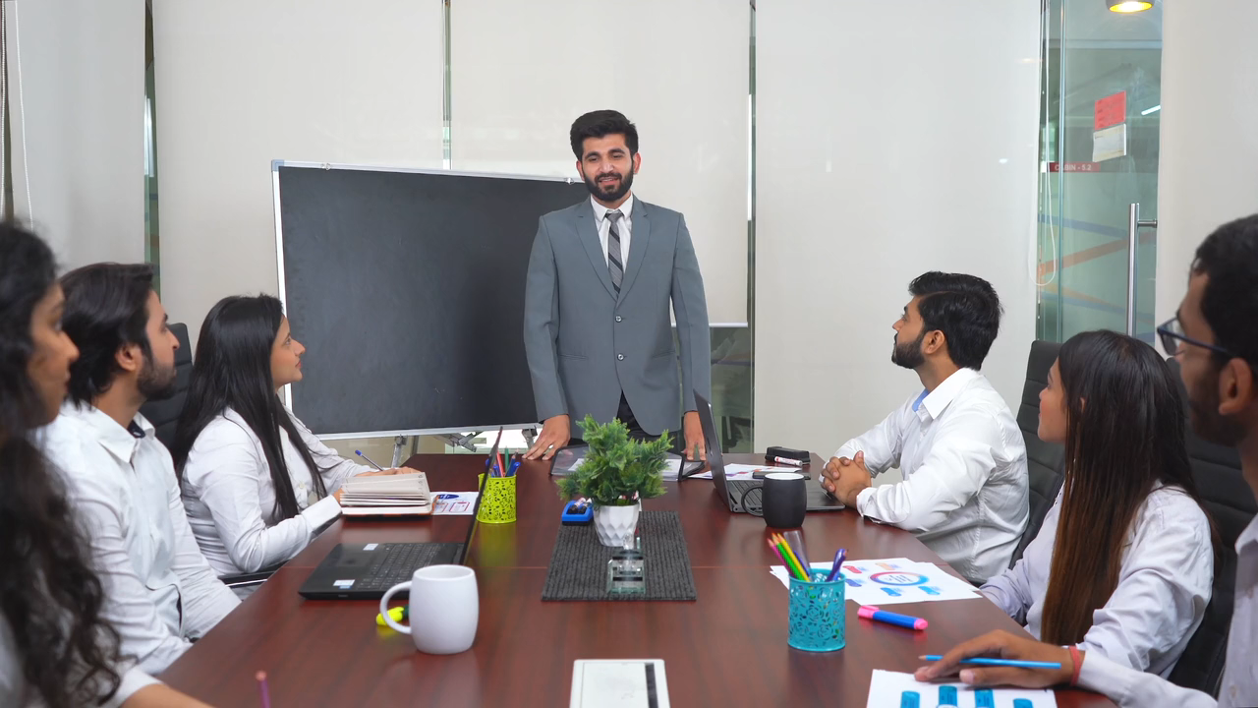
結果
Notes:
https://pixabay.com/videos/office-corporate-business-95126/

Slide 6
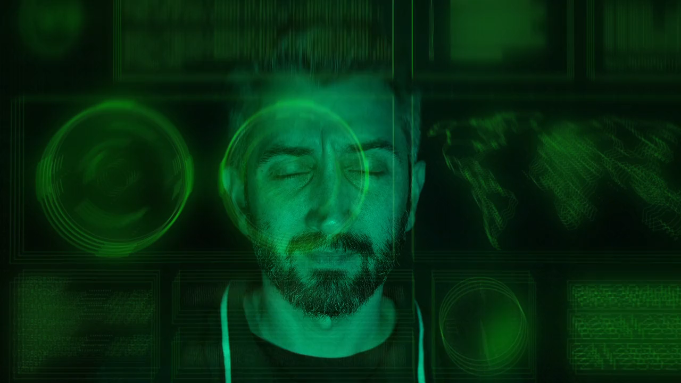
意外
Notes:
https://pixabay.com/videos/alert-alarm-war-danger-risk-205519/

Slide 7

轉彎
Notes:
https://pixabay.com/videos/ai-generated-hands-typing-laptop-172529/

Slide 8
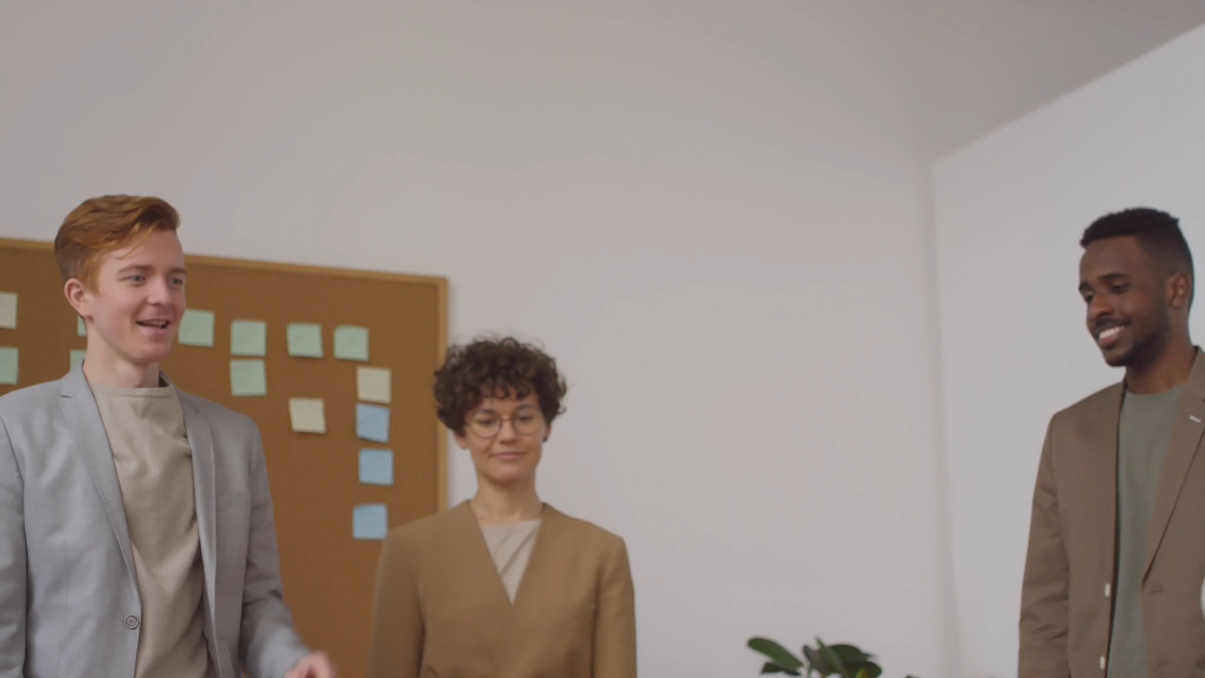
結局
Notes:
https://pixabay.com/videos/team-office-work-success-70345/

